Slide 1
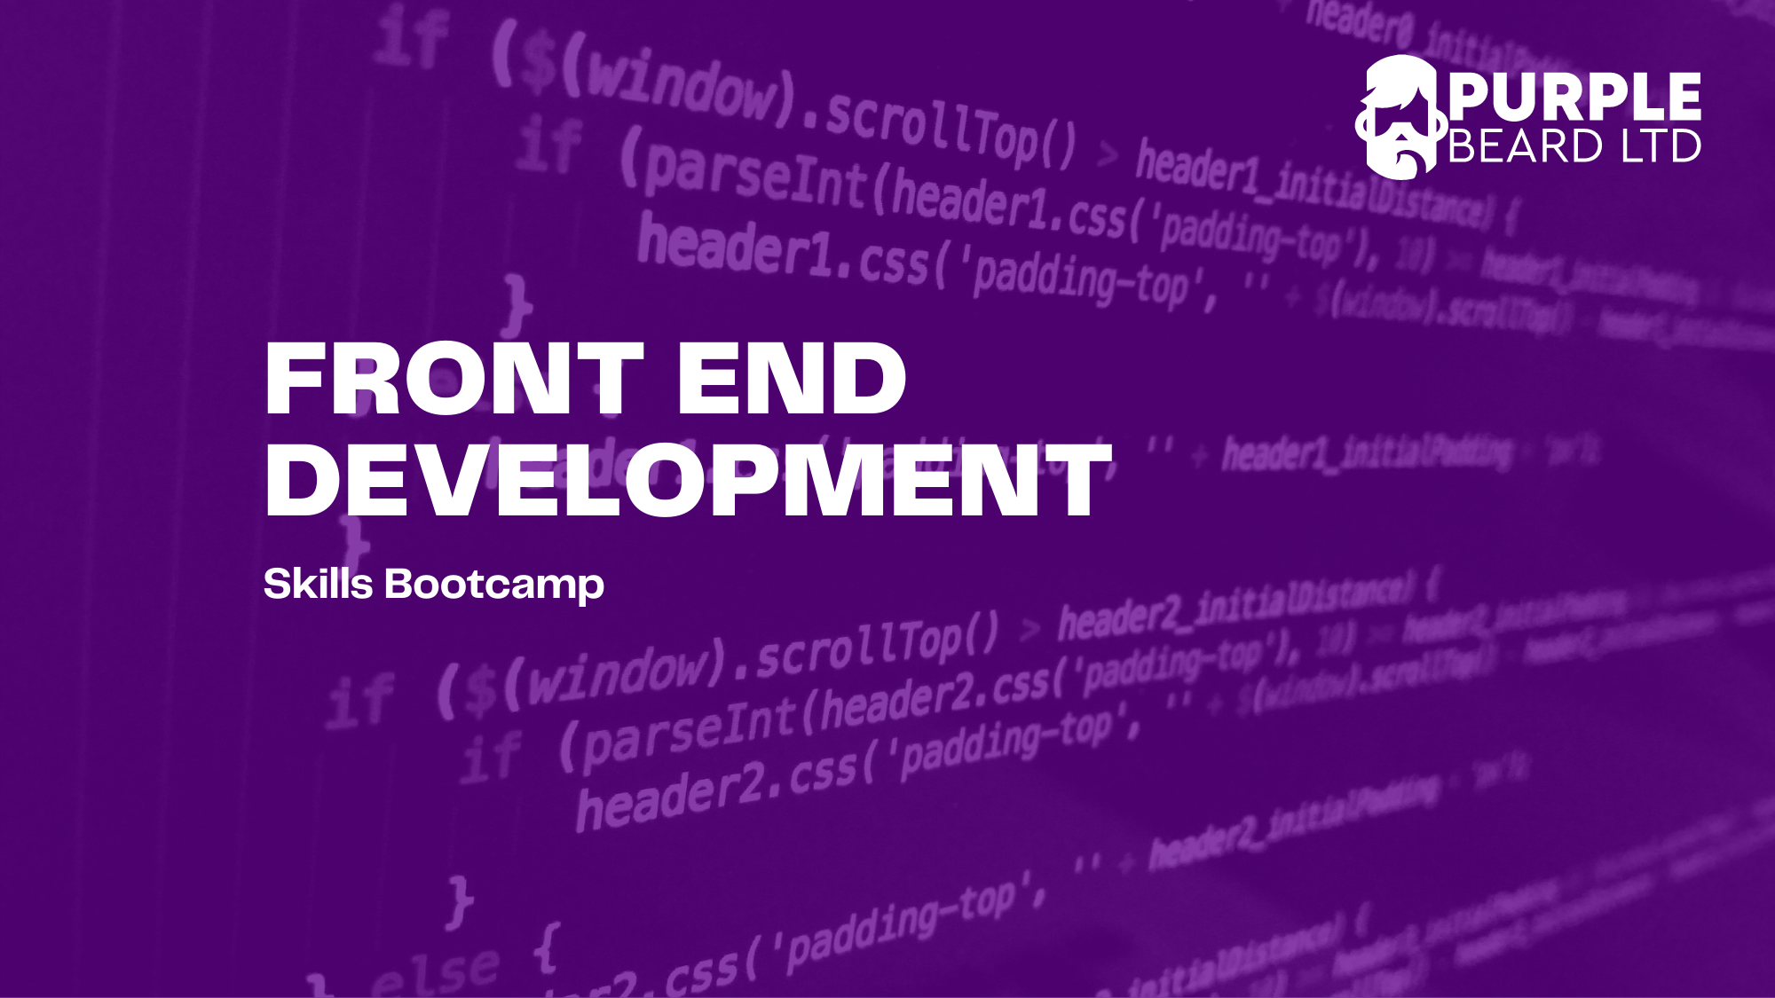
JavaScript 5

Slide 2
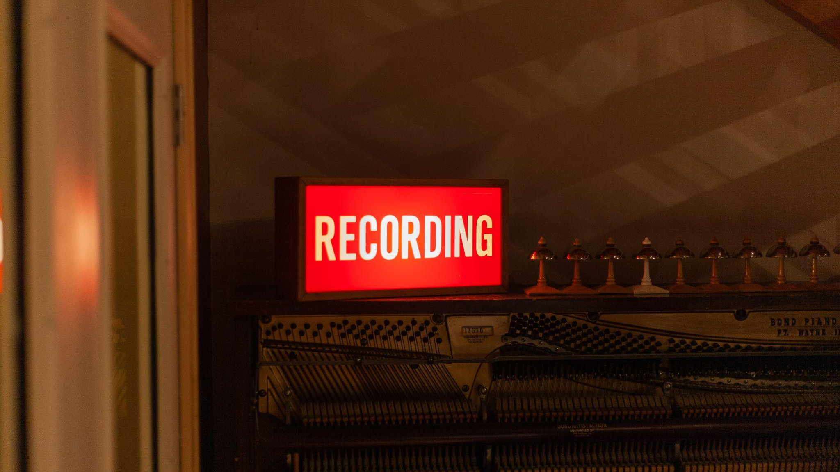

Slide 3
Live Coding: Asynchronous Callbacks
Asynchronous code in JavaScript and the event loop
Set timeout
Callback hell

Slide 4
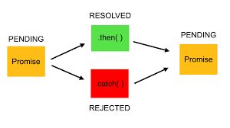

Slide 5
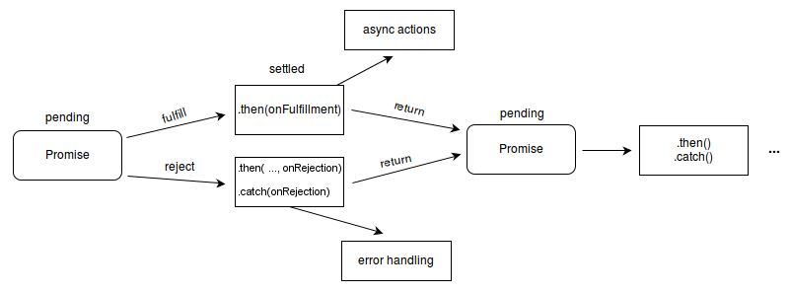

Slide 6
Live Coding: Promises
Syntax
Then
Pending, fulfilled and rejected

Slide 7
Live Coding: Fetch
Fetch Syntax
Fetch wrapper

Slide 8
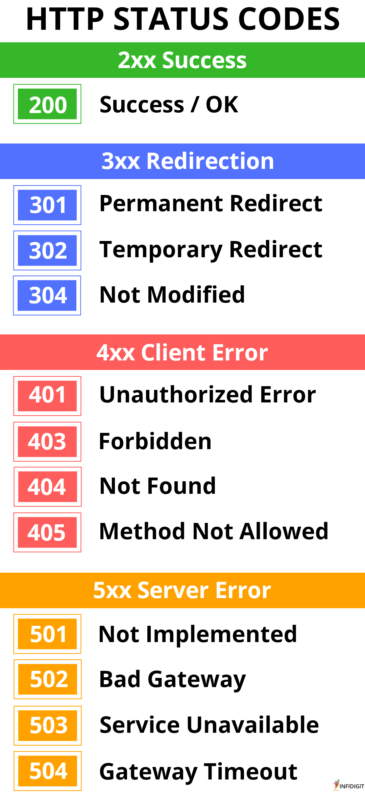

Slide 9
Exercise
Call the api (https://mdn.github.io/learning-area/javascript/apis/fetching-data/can-store/products.json) using fetch method in JavaScript.
Print the first name in the array of objects.
Print the length of the array.
Loop over the array and print all the names.

Slide 10
Live Coding: Open Weather API

Slide 11
Live Coding: IMDB API

Slide 12
Live Coding: Async/Await
Async/Await Syntax

Slide 13
Homework
Have a go at creating your own website with either open weather API or IMDB API or another free API. Publish the site to GitHub pages and had it in as an assignment.
Note – TA set up assignment

Slide 14
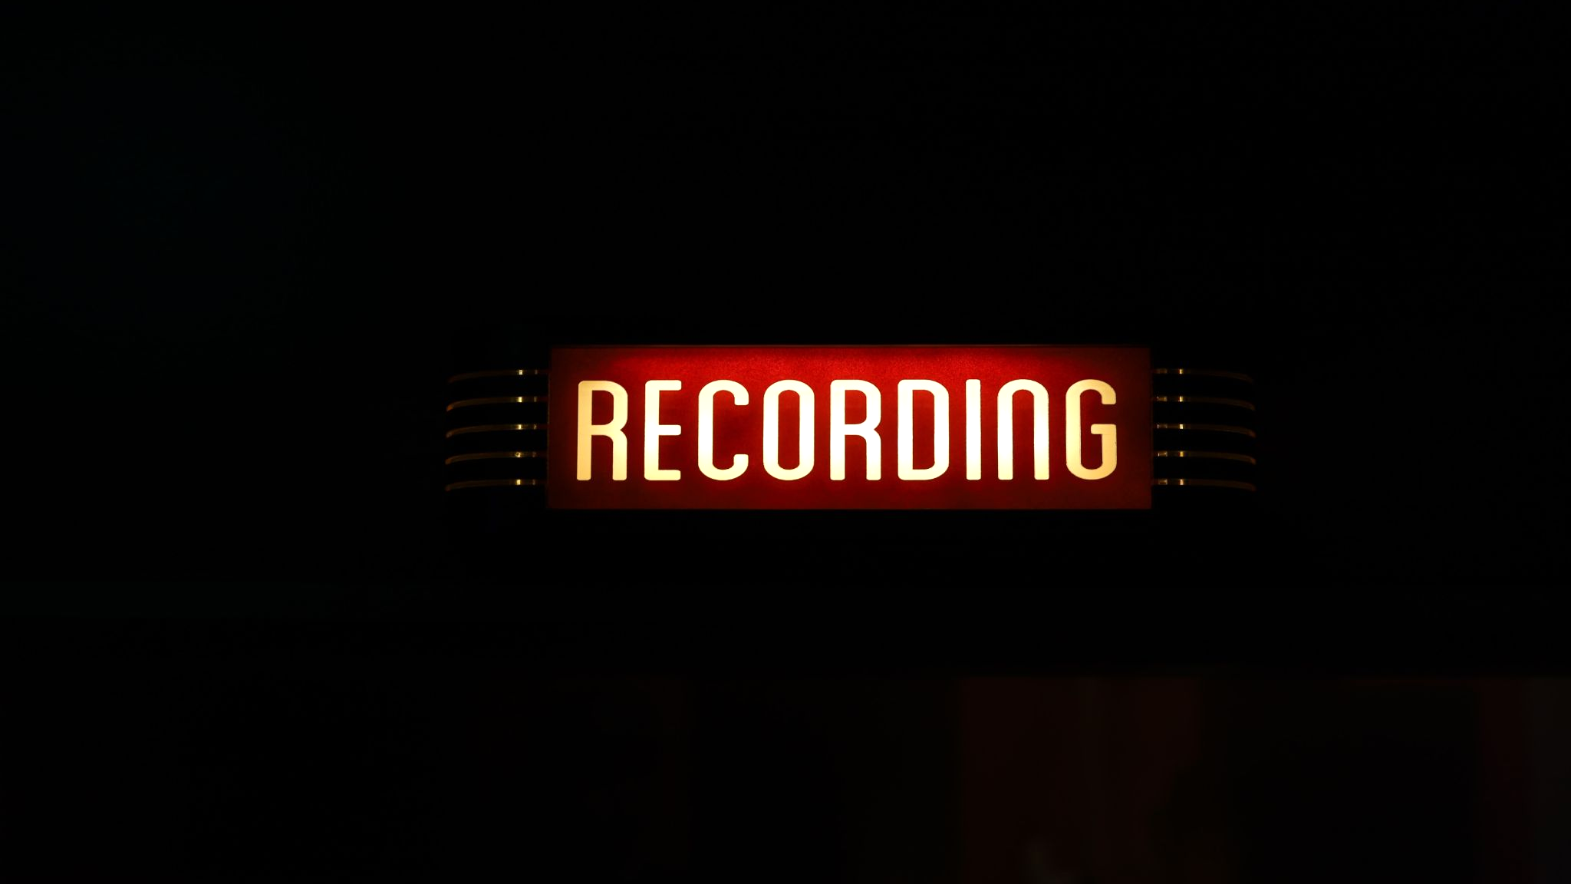

Slide 15

Questions?
JavaScript 1

